Slide 1
Module 2

Slide 2
Arrays
Arrays are used to store multiple values in a single variable, instead of declaring separate variables for each value.
To create an array, define the data type (like int) and specify the name of the array followed by square brackets [ ].
dataType arrayName[arraySize];
It is possible to initialize an array during declaration. For example,
To insert values to it, use a comma-separated list inside curly braces, and make sure all values are of the same data type:
Here, we haven't specified the size. However, the compiler knows its size is 5 as we are initializing it with 5 elements.

Slide 3
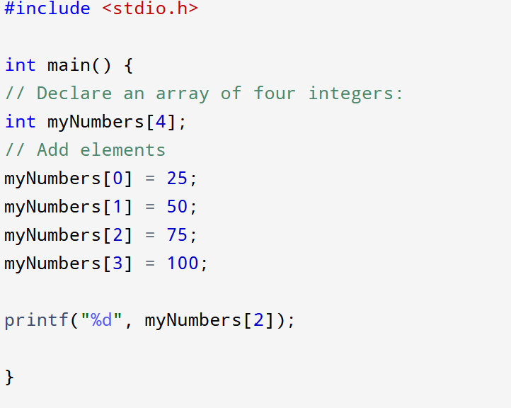
Another common way to create arrays, is to specify the size of the array, and add elements later:
Example

Slide 4
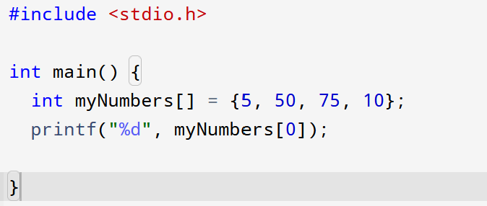

Access the elements of an array
To access an array element, refer to its index number.
Array indexes start with 0: [0] is the first element. [1] is the second element, etc.

Slide 5
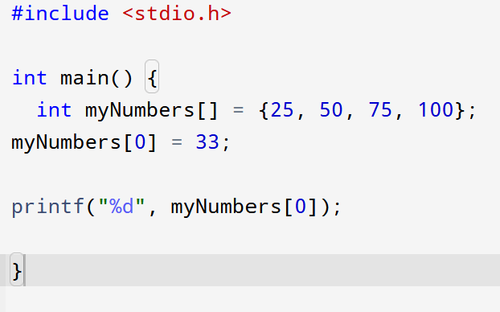
Change an Array Element
To change the value of a specific element, refer to the index number:
Eg: myNumbers[0] = 33;

Slide 6
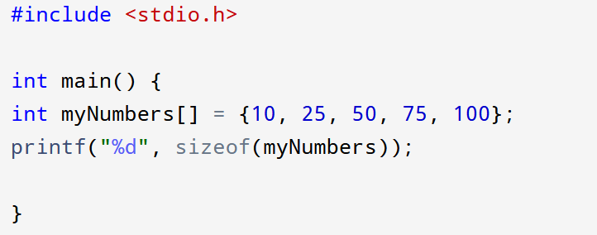

Get Array Size or Length
To get the size of an array, you can use the sizeof operator:
Why did the result show 20 instead of 5, when the array contains 5 elements?
- It is because the sizeof operator returns the size of a type in bytes.
int type is usually 4 bytes, so from the example above, 4 x 5 (4 bytes x 5 elements) = 20 bytes.

Slide 7
when you just want to find out how many elements an array has, you can use the following formula (which divides the size of the array by the size of the first element in the array):

Slide 8
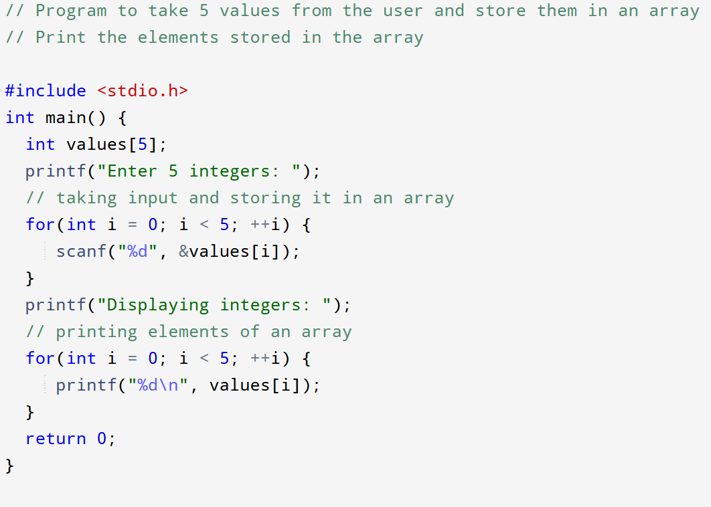
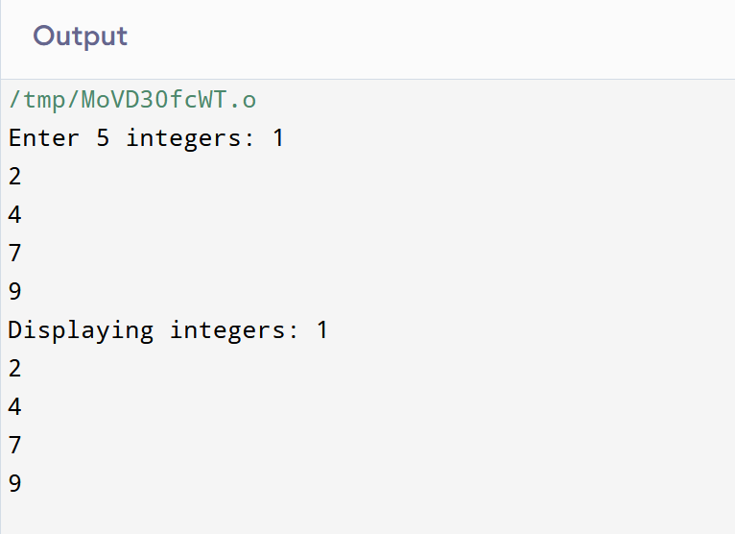
Array Input/Output

Slide 9
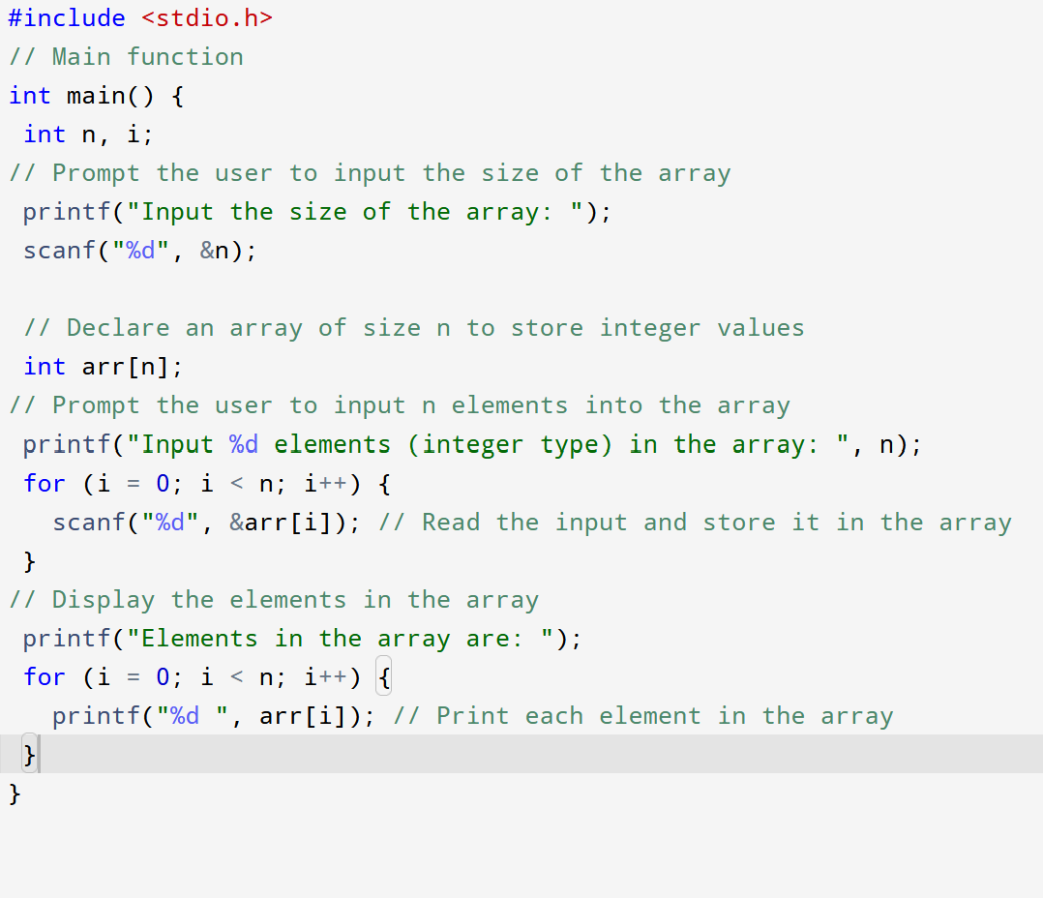
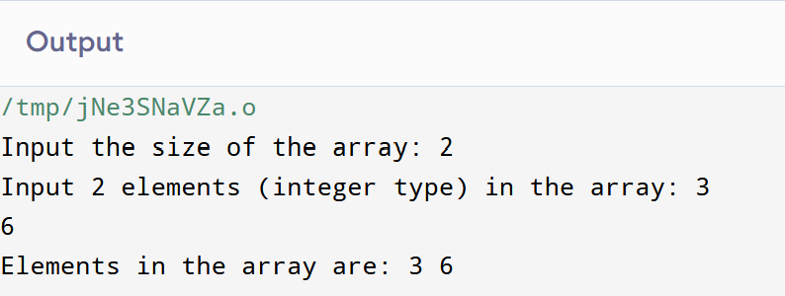
Read and print elements of a C array of any size?

Slide 10
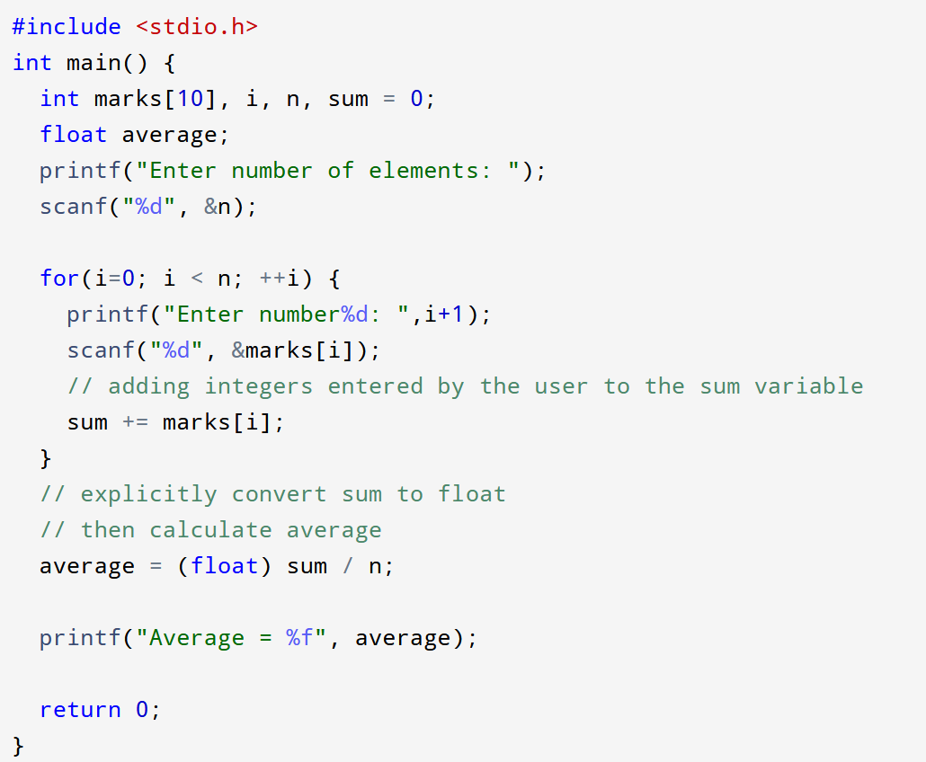
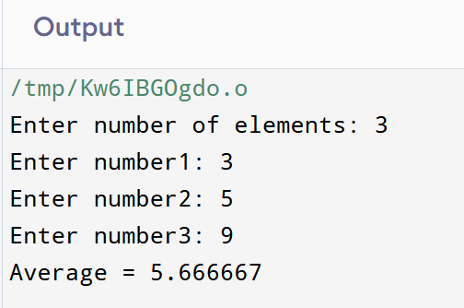
Program to find the average of n numbers using arrays

Slide 11
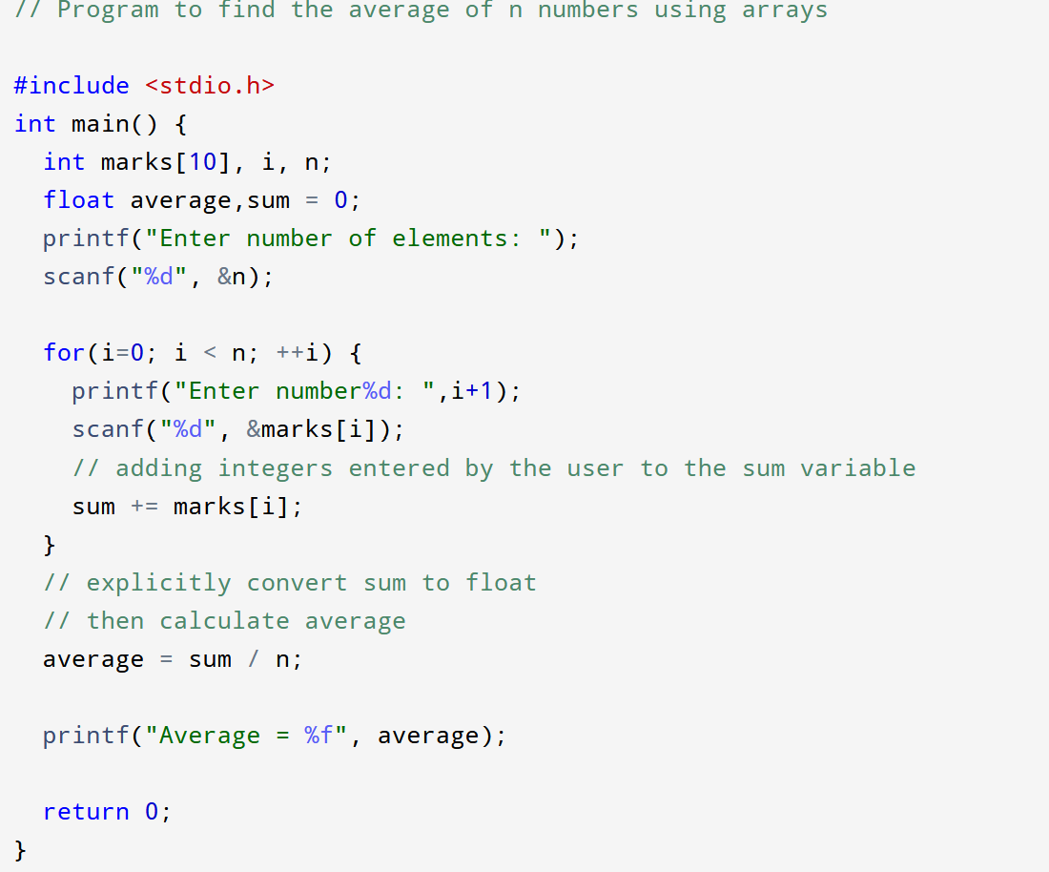

Slide 12
Multidimensional Arrays in C
A multi-dimensional array can be defined as an array that has more than one dimension. Having more than one dimension means that it can grow in multiple directions. Some popular multidimensional arrays are 2D arrays and 3D arrays.
Syntax
The general form of declaring N-dimensional arrays is shown below:
Datatype arr_name[size1][size2]….[sizeN];
dataype: Type of data to be stored in the array.
arr_name: Name assigned to the array.
size1, size2,…, sizeN: Size of each dimension.

Slide 13
Initialization of 2D arrays
Note: The number of elements in initializer list should always be either less than or equal to the total number of elements in the array.
int arr[3][4] = {0, 1 ,2 ,3 ,4 , 5 , 6 , 7 , 8 , 9 , 10 , 11}
Or
int arr[3][4] = {{0, 1, 2, 3}, {4, 5, 6, 7}, {8, 9, 10, 11}};
The elements will be stored in the array from left to right and top to bottom.
So, the first 4 elements from the left will be filled in the first row, the next 4 elements in the second row, and so on.
This is clearly shown in the second syntax where each set of inner braces represents one row.

Slide 14
Access the Elements of a 2D Array
To access an element of a two-dimensional array, you must specify the index number of both the row and column.
This statement accesses the value of the element in the first row (0) and third column (2) of the matrix array.
Example
int matrix[2][3] = { {10, 20, 30}, {40, 50, 60} }; printf("%d", matrix[0][1]); // Outputs 20
Updation
matrix[0][0] = 15;

Slide 15
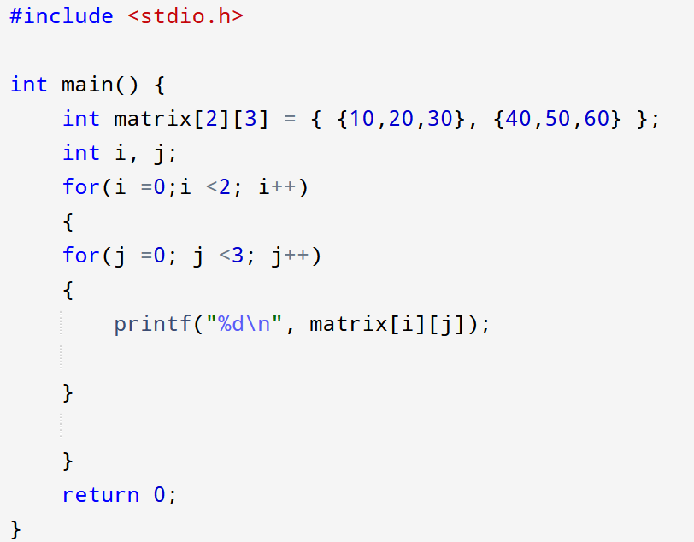
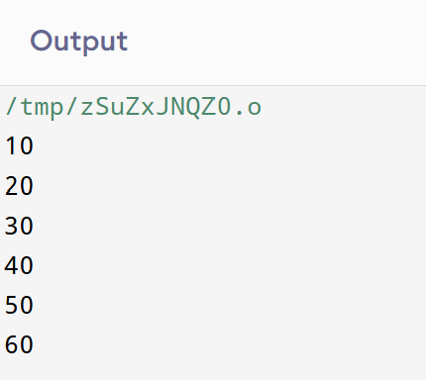
Loop Through a 2D Array

Slide 16
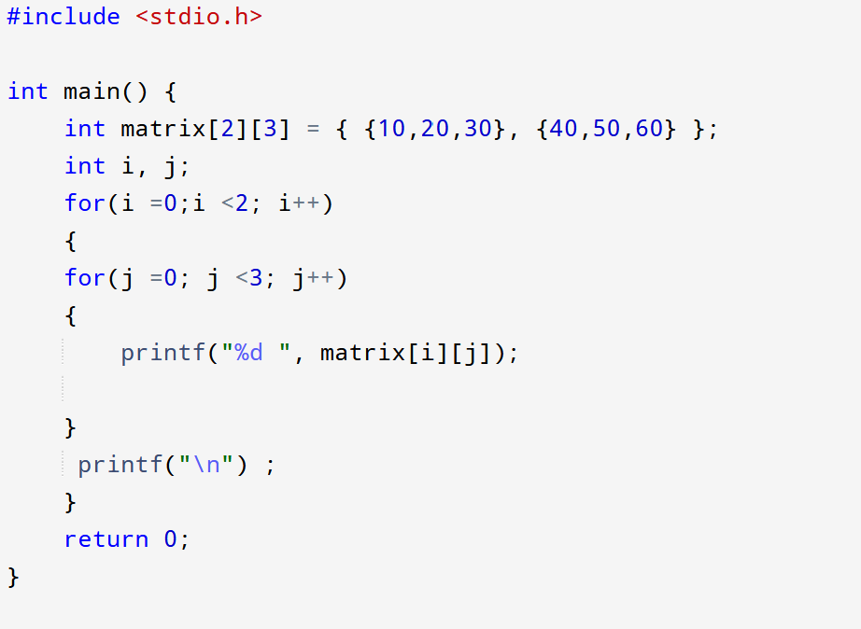
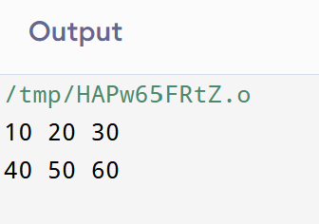
Loop Through a 2D Array

Slide 17
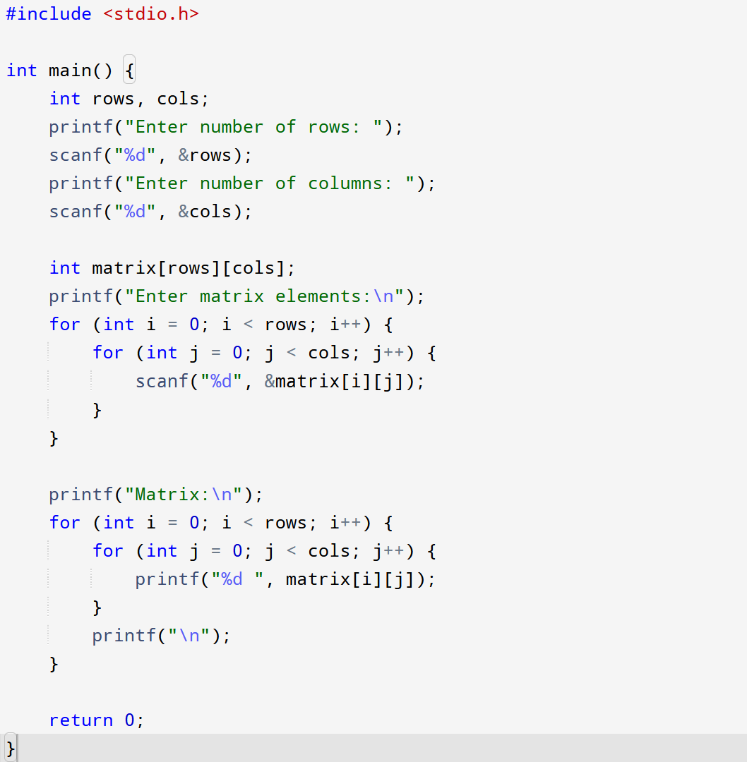
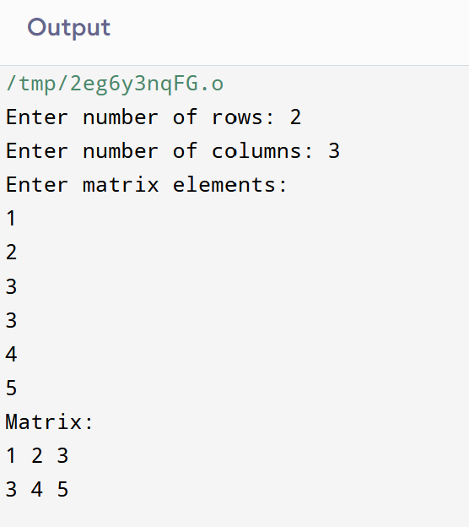
Create and display matrix

Slide 18
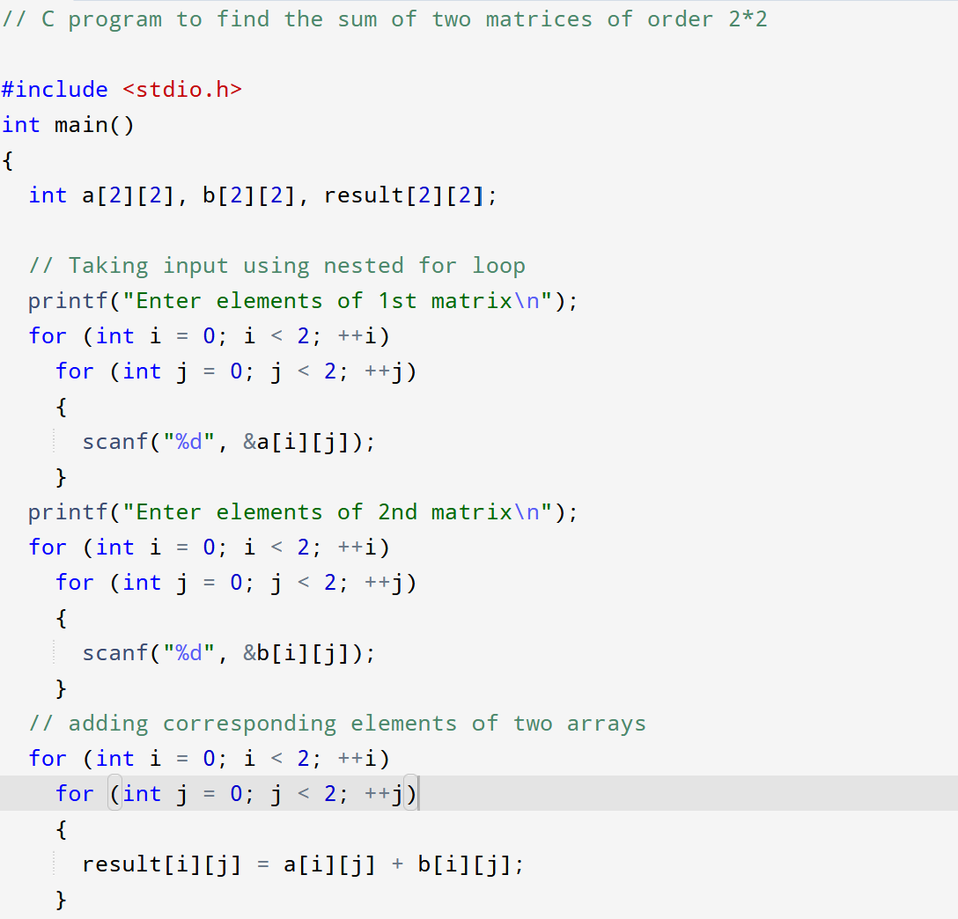
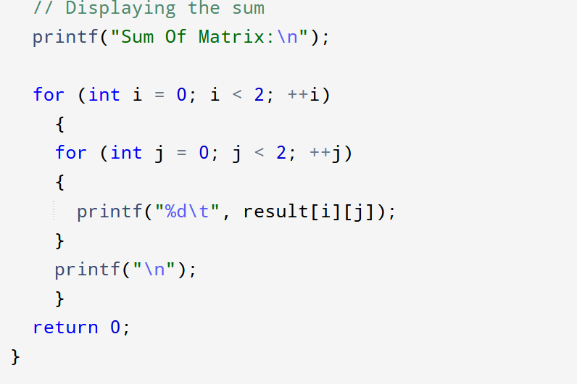
C program to find the sum of two matrices of order 2 X 2

Slide 19
Pointers
We can get the memory address of a variable with the reference operator &:​
Eg:​ int Age = 27; // an int variable​
printf("%d", Age); // Outputs the value of Age (27)​
printf("%p", &Age); // Outputs the memory address of Age
A pointer is a variable that stores the memory address of another variable as its value.​
A pointer variable points to a data type (like int) of the same type, and is created with the * operator.​
The address of the variable you are working with is assigned to the pointer:​

Slide 20
Pointer Syntax
Here is how we can declare pointers.
int* p;
Here, we have declared a pointer p of int type.
Assigning addresses to Pointers:
int* pc, c;
c = 5;
pc = &c;
Here, 5 is assigned to the c variable. And, the address of c is assigned to the pc pointer.

Slide 21
Get Value of Thing Pointed by Pointers
To get the value of the thing pointed by the pointers, we use the * operator. For example:
int* pc, c;
c = 5;
pc = &c;
printf("%d", *pc); // Output: 5
Here, the address of c is assigned to the pc pointer. To get the value stored in that address, we used *pc.
Note: In the above example, pc is a pointer, not *pc. You cannot and should not do something like *pc = &c;
* is called the dereference operator (when working with pointers). It operates on a pointer and gives the value stored in that pointer.

Slide 22
C – Importance of pointers
Pointers are one of the things that make C stand out from other programming languages, like Python and Java.
With pointers, you can access and modify the data located in the memory, pass the data efficiently between the functions, and create dynamic data structures like linked lists, trees, and graphs.
They are important in C, because they allow us to manipulate the data in the computer's memory. This can reduce the code and improve the performance. And sometimes you even have to use pointers, for example when working with files and memory management.
But be careful; pointers must be handled with care, since it is possible to damage data stored in other memory addresses.

Slide 23
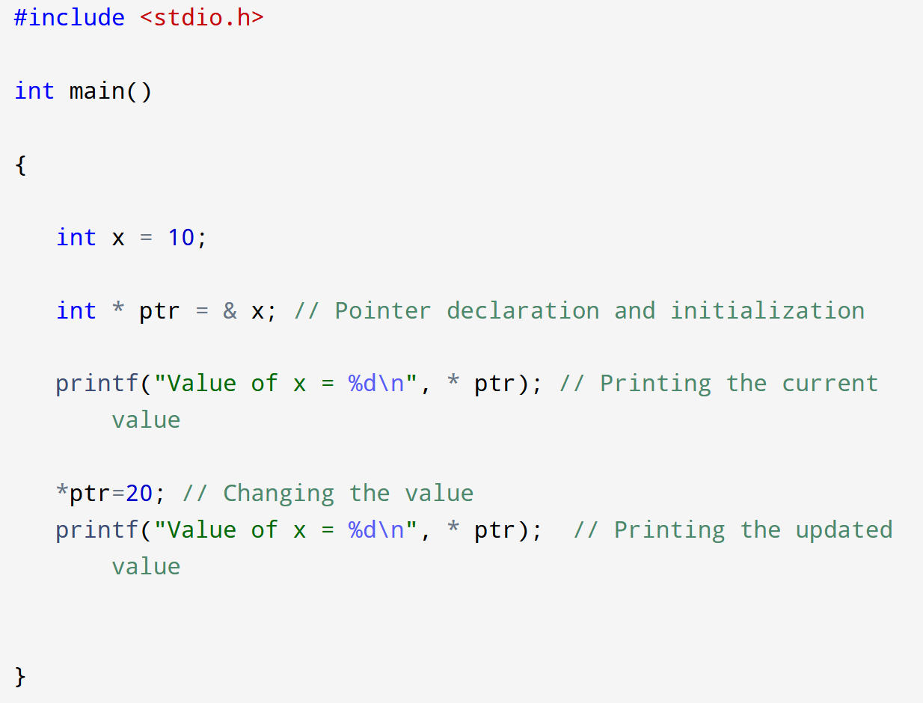
C – Access and Manipulate Values using Pointer
The value of the variable which is pointed by a pointer can be accessed and manipulated by using the pointer variable.
You need to use the asterisk (*) sign with the pointer variable to access and manipulate the variable's value.

Slide 24
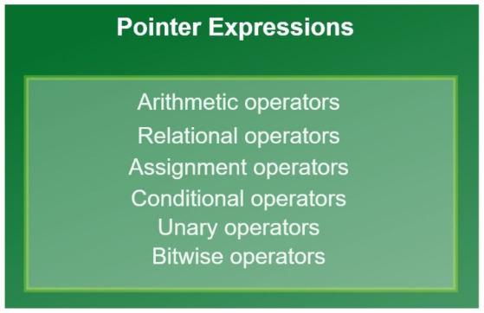
Pointer Expressions
Just like any other variable, these operations can be also performed on pointer variables.

Slide 25
Arithmetic operations using pointers
We can add an integer or subtract an integer using a pointer pointing to that integer variable.
Operations possible (Addition, subtraction, multiplication, division & modulo)
Examples:
*ptr1 + *ptr2 *ptr1 * *ptr2 *ptr1 + *ptr2 - *ptr3
Can also directly perform arithmetic expressions on integers by dereferencing pointers.
*p1 + 10, *p2 - 5, *p1 - *p2 + 10, *p1/2
Similarly we can write expressions using relational, conditonal, unary, assignment, bitwise operators also.
While performing division, make sure you put a blank space between ‘/’ and ‘*’ of the pointer as together it would make a multi-line comment(‘/*’).

Slide 26
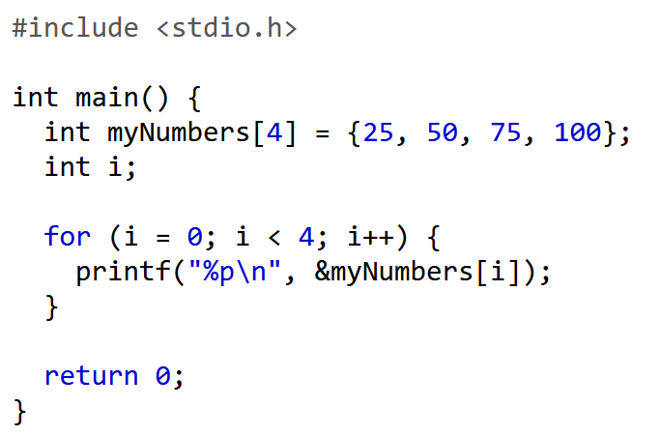
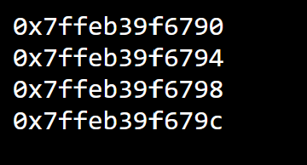
Pointers and arrays
You can also use pointers to access arrays.
Example
Note that the last number of each of the elements' memory address is different, with an addition of 4.

Slide 27
Pointers and arrays
How Are Pointers Related to Arrays
The name of an array, is actually a pointer to the first element of the array.
int myNumbers[4] = {25, 50, 75, 100};
printf("%p\n", myNumbers); // 0x7ffe70f9d8f0
printf("%p\n", &myNumbers[0] ; // 0x7ffe70f9d8f0
printf("%d", *myNumbers); //25 Since myNumbers is a pointer to the first element in myNumbers, you
can use the * operator to access it:
To access the rest of the elements in myNumbers, you can increment the pointer/array (+1, +2, etc):
printf("%d\n", *(myNumbers + 1)); // 50 printf("%d", *(myNumbers + 2)); // 75

Slide 28
Pointers and arrays
How Are Pointers Related to Arrays
We can also use loops to access the array elements
int myNumbers[4] = {25, 50, 75, 100}; int *ptr = myNumbers; int i; for (i = 0; i < 4; i++)
{ printf("%d\t", *(ptr + i)); //25 50 75 100 }
We can update the value of array elements with pointers:
*myNumbers = 13; //1st element
*(myNumbers +1) = 17; //2nd

Slide 29
Programs on Arrays and Pointers in C
With Code and Output Examples

Slide 30
1. Accessing Array Elements using Pointers
Program:
#include <stdio.h>
int main(){
int arr[3] = {10,20,30};
int *ptr = arr;
for(int i=0;i<3;i++){
printf("%d ", *(ptr+i));
}
return 0;
}
Output:
10 20 30

Slide 31
Pointer to structure in C
You can use pointers with structs to make your code more efficient, especially when passing structs to functions or changing their values.
To use a pointer to a struct, just add the * symbol, like you would with other data types.
To access its members, you must use the -> operator instead of the dot . syntax:

Slide 32
Example
// Define a struct
struct Car {
char brand[50];
int year;
};
int main() {
struct Car car = {"Toyota", 2020};
// Declare a pointer to the struct
struct Car *ptr = &car;
// Access members using the -> operator
printf("Brand: %s\n", ptr->brand);
printf("Year: %d\n", ptr->year);
return 0;
}

Slide 33
2. Pointer to Structure
Program:
struct Student {
int id;
char name[20];
};
int main(){
struct Student s1 = {1, "John"};
struct Student *ptr = &s1;
printf("%d %s", ptr->id, ptr->name);
return 0;
}
Output:
1 John

Slide 35
3. Array Elements using Pointer
Program:
#include <stdio.h>
int main(){
int arr[5] = {1,2,3,4,5};
int *ptr = arr;
int sum=0;
for(int i=0;i<5;i++){
sum += *(ptr+i);
}
printf("Sum = %d", sum);
return 0;
}

Slide 36
4. Pointer Arithmetic
Program:
#include <stdio.h>
int main(){
int arr[3] = {5,10,15};
int *ptr = arr;
printf("%d\n", *ptr);
printf("%d\n", *(ptr+1));
printf("%d\n", *(ptr+2));
return 0;
}
Output:
5
10
15

